Slide 1


Green Pace
Security Policy Presentation
Developer: Ryan O’Connor
This is a presentation of the Green Pace security policy. This policy is meant to provide guidelines for the implementation of recommended security features.

Slide 2

OVERVIEW: DEFENSE IN DEPTH

Slide 3
THREATS MATRIX
Loss of network | SQL injection
Memory Leakage | Not using smart pointers

Slide 4
10 PRINCIPLES
Validate Input Data
When a user enters information into the software it will need to be validated. This ensures that the software is getting information that it is expecting. This can prevent crashes and bugs. It also prevents malicious actors from entering information that corrupt or grant unwanted access to a database or server.
Heed Compiler Warnings
Compiler warnings are added to software because they help fix known issues. Many times these compiler warnings can prevent bugs from happening later on in development but can also help secure code. Typically if the compiler is giving a warning it is flagging a known issue which the developer should interpret as a security issue or bug that has already happened and can be prevented.
Architect and Design for Security Policies
In order to protect the integrity of the software system developers should examine how the safeguards are being implemented in their software. This implementation of the software safeguards and enforcement of the security policies can help to protect the information being handled by the system. This will protect how data is used, stored, and retrieved.
Keep It Simple
Some of the most basic solutions are the most effective. Keeping the design of the software simple also makes it easier to secure the software. If all the parts of the software system are easily understood then the development team will be able to employ much more effective security strategies.
Default Deny
The default mode of the software should deny access. Only users that have been authenticated and identified should have the ability to access part of the system or software.
Adhere to the Principle of Least Privilege
One part of the program may not require information from other parts. It is important to limit the access to information to only what is needed to accomplish the task of that portion of the software. This will reduce the risk that hackers can gain access to critical parts of the system from an unexpected source.
Sanitize Data Sent to Other Systems
It is important to specify the data that is being sent from one system to another. If a function is expecting an integer and it receives a string then errors can occur. It is important for the system to check the data that is being passed to ensure that it meets the expectations of the parts of the system that will be consuming the data.
Practice Defense in Depth
By layering the defense strategies the team can increase the efficacy of the different security strategies. This will help the team detect attempted attacks and also makes it much harder for malicious actors to gain access to critical parts of the software system.
Use Effective Quality Assurance Techniques
Quality assurance ensures that the software being produced meets the standards of the company. These techniques should be incorporated into the development process to ensure that the final product is secure and meets the needs of the stakeholders.
Adopt a Secure Coding Standard
Unsafe coding practices can result in the loss of information. This can also damage the reputation of the company. It is important for all team members to adopt secure coding standards as part of their normal repertoire.

Slide 5
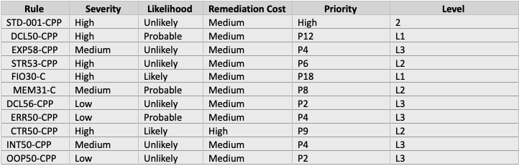
CODING STANDARDS
The coding standards are a list of rules which are defined by Carnegie Mellon University (cmu.edu). The ranking system is based off the severity of the risk, how likely it is to occur, and the cost associated with a breach. Each rule is also given a priority and a level.

Slide 6
ENCRYPTION POLICIES
Encryption in rest
Ensures that data stored on disk is encrypted which makes it more difficult for a hacker to access the data in the event of theft.
Encryption at flight
This is the process of encrypting data while it is being transmitted.
Encryption in use
A method for using data while it is in it’s encrypted state so that decryption is not necessary for an application to run. This can be done by trusting the hardware or trusting the end application.

Slide 7
TRIPLE-A POLICIES
Authentication
The process is verifying the identity of the user with user logins via password or two-factor authentication.
Authorization
The process of determining the users level of access. Specify what an authenticated user is allowed to change on a database and how often they can access the database. Addition of new users should be a limited privilege granted only to administrative users.
Accounting
The process of keeping records of all user actions in logs. This should include all of the files accessed by the user.

Slide 8
Unit Testing
The coding vulnerability that was tested was the collections vector. Tests for this vector were meant to test the input as well as changes made to the vector. The vector was tested at creation and tear down also.

Slide 9
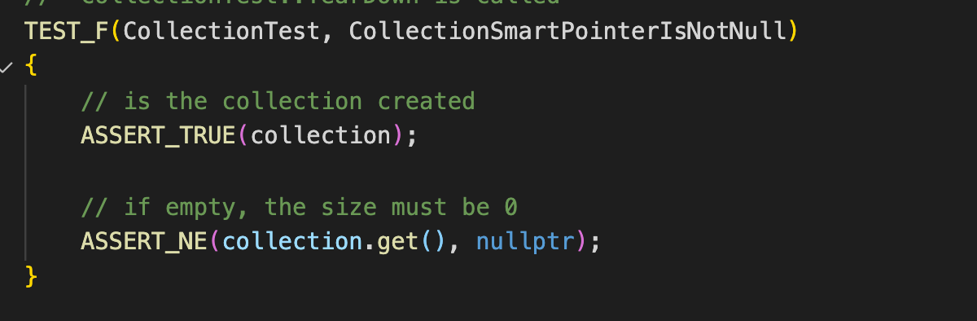
Test that a collection is empty when created.

Slide 10
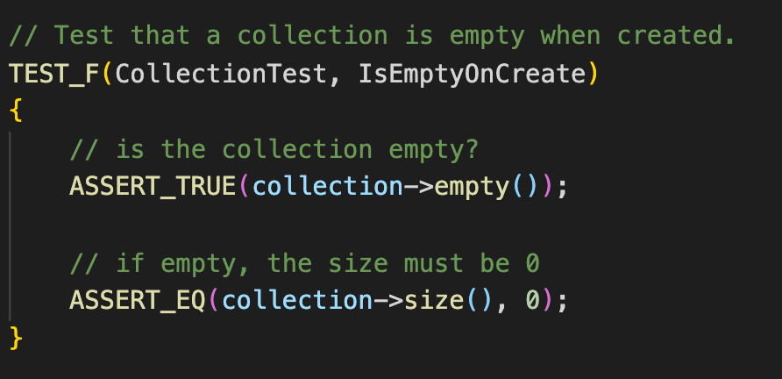
Test that a collection is empty when created.

Slide 11
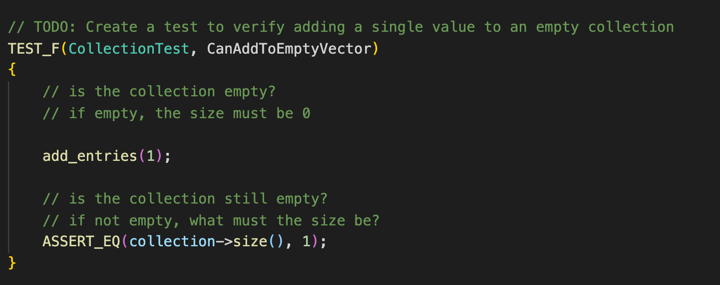
Create a test to verify adding a single value to an empty collection

Slide 12
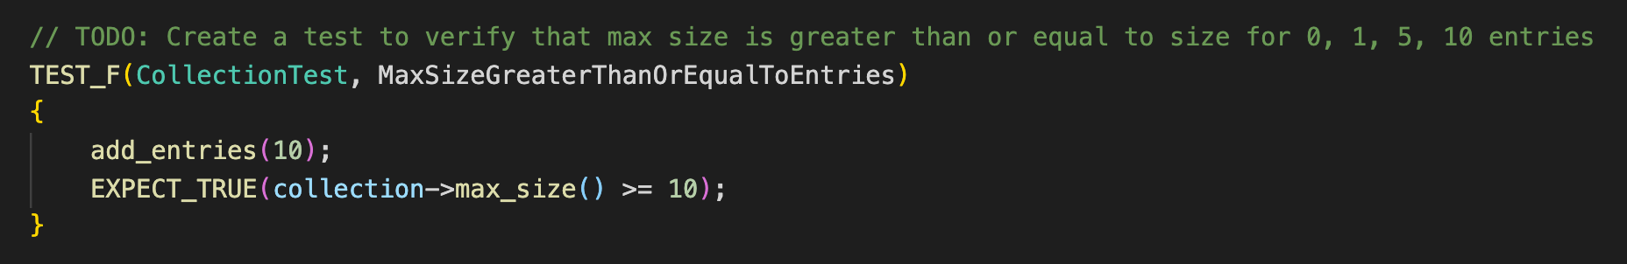
Create a test to verify that max size is greater than or equal to size for 0, 1, 5, 10 entries

Slide 13
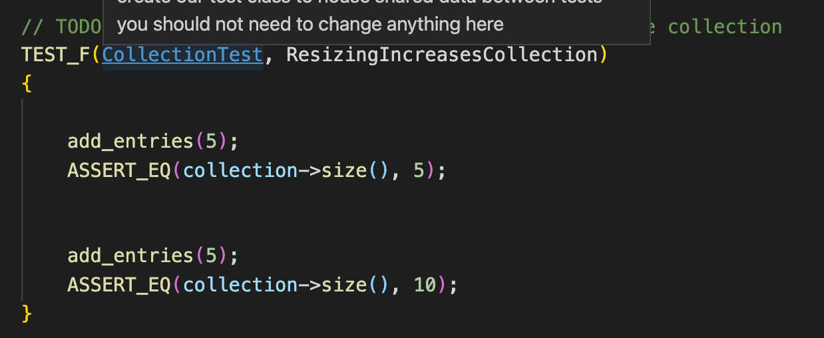
Create a test to verify resizing increases the collection

Slide 14
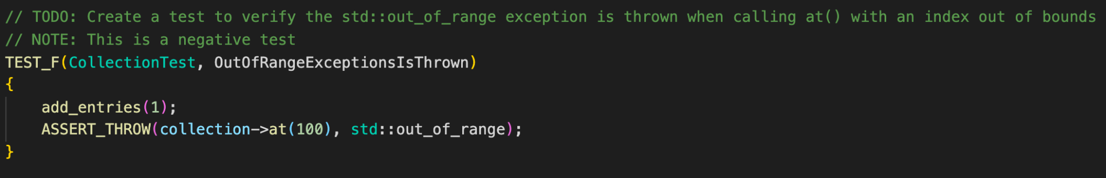
Create a test to verify the std::out_of_range exception is thrown when calling at() with an index out of bounds

Slide 15

AUTOMATION SUMMARY

Slide 16
TOOLS
DevSecOps is the process for continuously integrating securing into development. This is enforced with a series of checks starting before code is committed and running until code is built, tested and deployed.
We will use the Google test suite to run automated tests on code that is committed to ensure that the identified risks have been minimized.

Slide 17
RISKS AND BENEFITS
The risks and benefits of enacting the system increase the sooner the measures are taken. The risks of not enacting a security plan could include a loss of data or intellectual property. Or damage to the company's reputation.

Slide 18
RECOMMENDATIONS
Areas for improvement would be unit tests for all data transferred in the system. Another improvement could be the encryption of data as it is passed throught the server. The gaps in the security plan are that it is not scaled over time. New threats are not accounted for. The best way to resolve these issues would be to create a team with the goal of developing and securing code as it is created.

Slide 19
CONCLUSIONS
A Defense in Depth standard should be adopted as soon as possible.

Slide 20
REFERENCES
[Provide APA-style references with links to resources, articles, and videos that you used in your presentation.]

